Slide 1
How to use the mini-quote system
Vendors

Slide 2
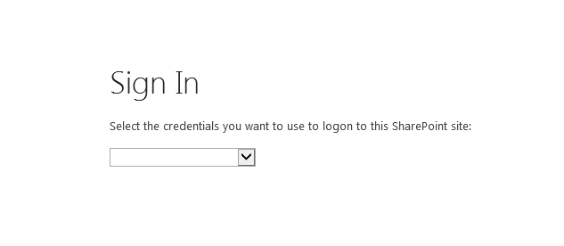
Also, please check the broadband for education website for important updates at: http://broadband4education.nm.gov
Navigate to: http://webed.ped.state.nm.us/sites/miniquote/mqs Best experience is in Internet Explorer in compatibility mode At the Login Screen, choose Forms Authentication.

Slide 3
Login with your account information

Slide 4
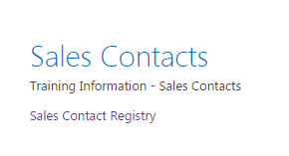
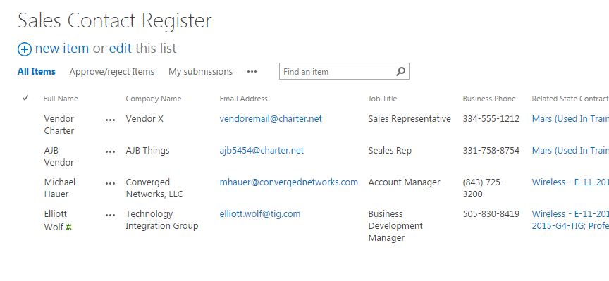
If you are accessing the site for the first time, please take a moment to register yourself and associate your account with a vendor and all your contracts
Click on
Sales contact Registry
on the home page
Then, click on new item
to register your
account with your company
and contracts

Slide 5
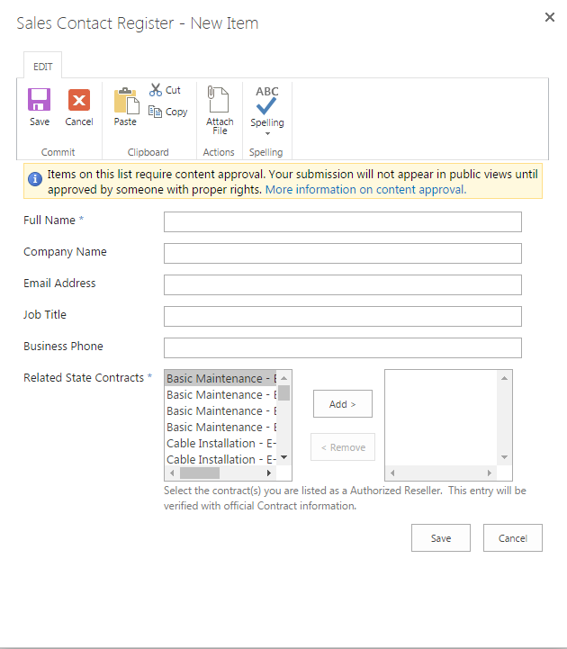
Complete the form in the pop up window and add your contracts

Slide 6
Review details and use the vendor general response to provide a quote
1. Click on Sales Contacts Maintenance
2. Ask questions via online discussion board

Slide 7
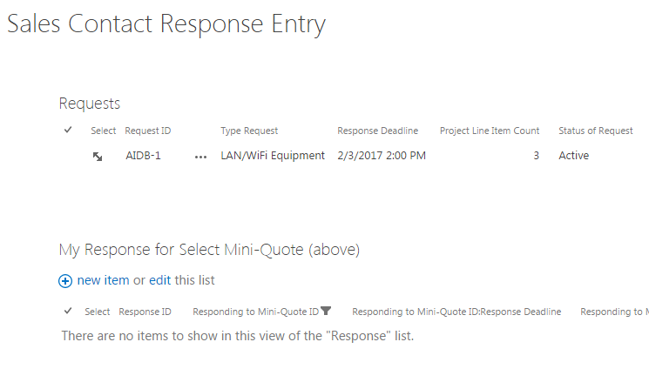
Review and respond to requests when you are ready to provide a quote
Click on new
item to respond

Slide 8
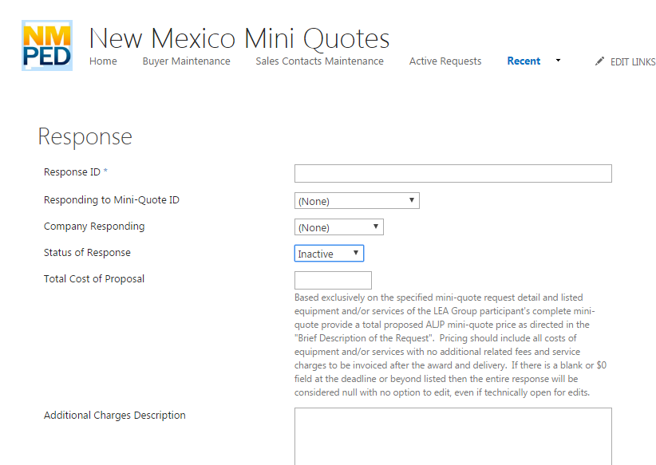
Click save when your response is completed. The school will be notified that a response has been submitted

